Slide 1
Branching & Loops
Lesson #6

Slide 2

Branching (IF statement)

Slide 3


“if – then – else- fi” Statement
Control Branching on Condition
Format #1 – Branch on TRUE or Continue:
  if [ value operation value ]
  then
  command list
  command list
  fi

Slide 4
“if – then – else- fi” Statement
Control Branching on Condition
Format #2 – Branch on TRUE or False:
  if [ value operation value ]
  then
  command list
  command list
  else
  command list
  command list
  fi
True
False

Slide 5
“if – then – else- fi” Statement
String Operation Compare
  =
  !=
Integer Operation Compare
  -ne
  -lt
  -eq
  -gt
  -le

Slide 6
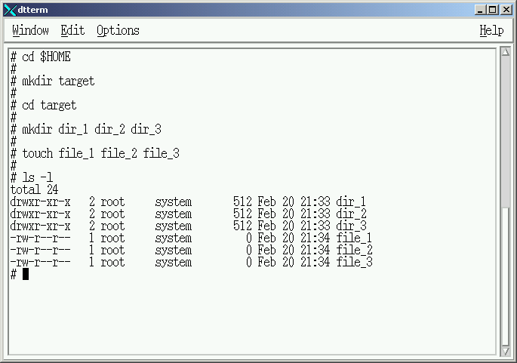
Lecture Preparation

Slide 7
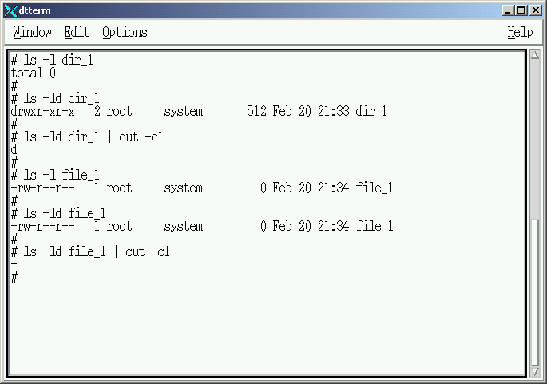
Command Explaination

Slide 8
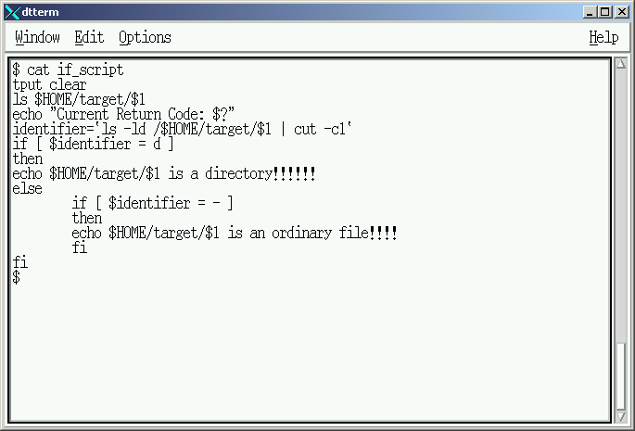
Create “if_script”

Slide 9
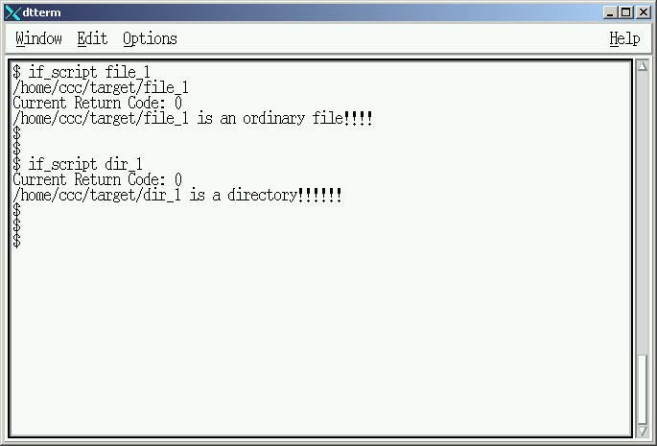
“if_script” Execution

Slide 10
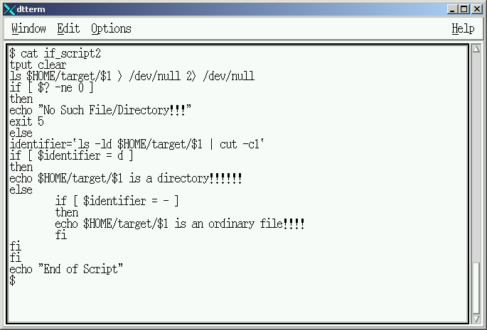
Create “if_script2”

Slide 11
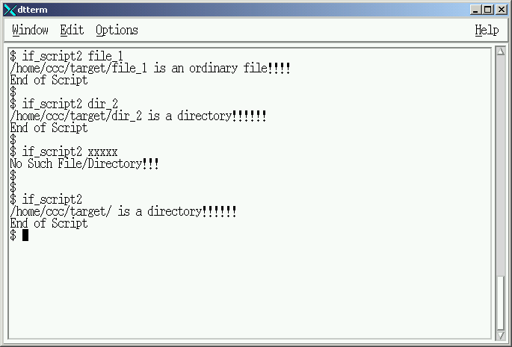
“if_script2” Execution
ERROR

Slide 12
Create “if_script2” Child

Slide 13
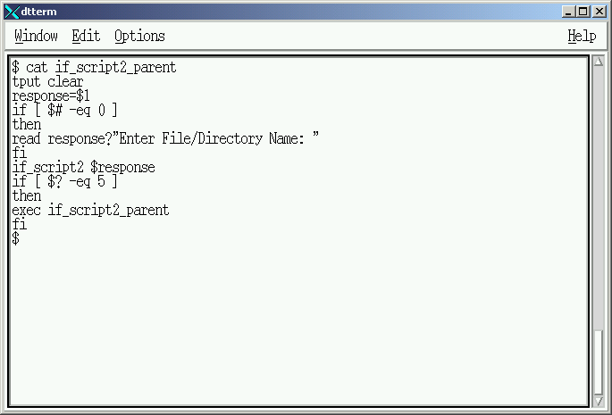
Create “if_script2_parent”

Slide 14
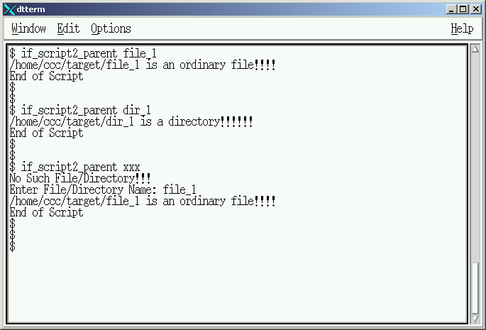
“if_script2” Execution

Slide 15
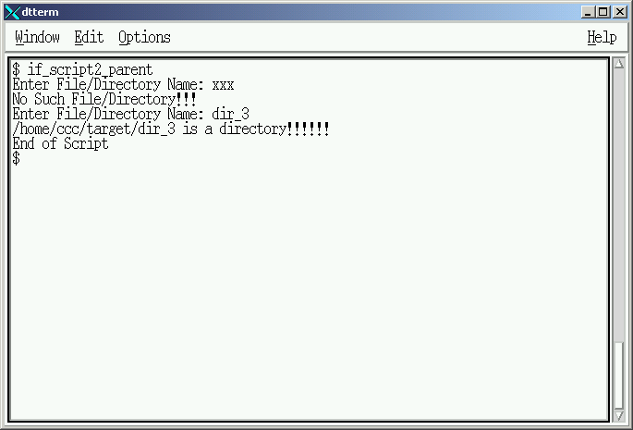
“if_script2” Execution

Slide 16
Looping (while – do - done)

Slide 17
“while – do - done” Statement
Control looping on Condition Testing
Format :
  while [ value operation value ]
  do
  command list
  command list
  done

Slide 18
“while – do - done” Statement
String Operation Compare
  =
  !=
Integer Operation Compare
  -ne
  -lt
  -eq
  -gt
  -le

Slide 19
“if_script2” Child

Slide 20
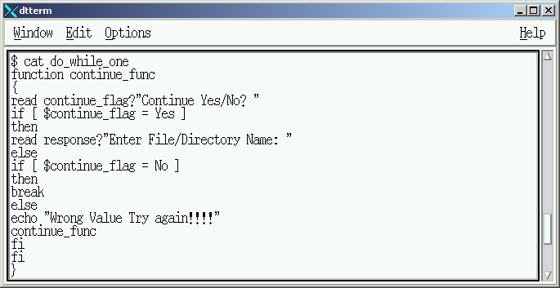
Create “do_while_one” Script

Slide 21
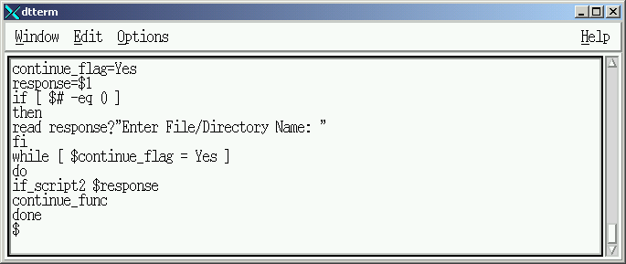
Create “do_while_one” Script

Slide 22
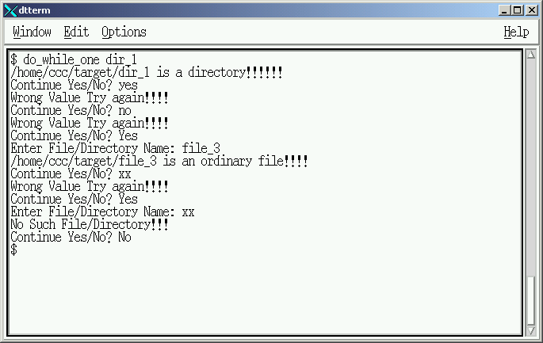
Create “do_while_one” Script

Slide 23
Classroom Exercise

Slide 24
Modifiy your “do_while_one” script to accept the following as valid responses from the operator using additional “IF” statements.
  “YES, Yes or yes”
  “NO, No or no”

Slide 25
Branching (case - esac)

Slide 26
“case” instruction
Control Branching on Condition
Replacement for Multiple “IF” instructions
Format :
  case $control_variable in
  variable content) command;;
  variable content) command;
  command;;
  *) command;;
  esac

Slide 27
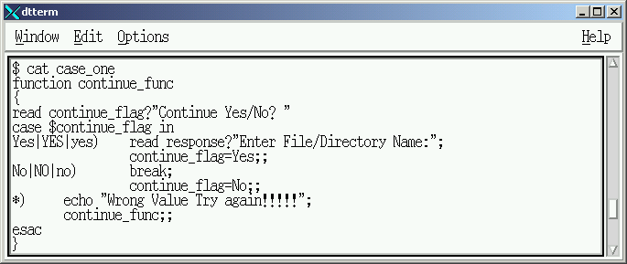
Create “case_one” Script

Slide 28
Create “case_one” Script

Slide 29
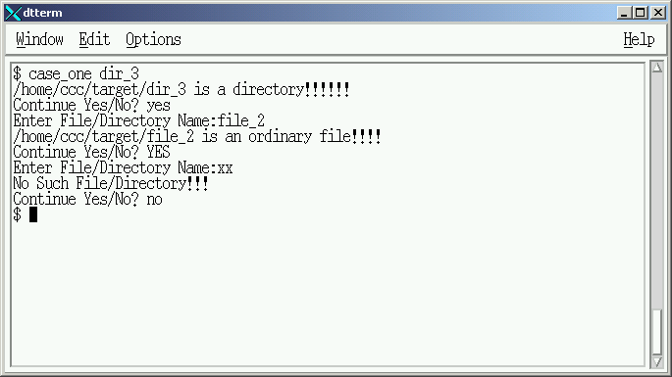
“case_one” Execution

Slide 30
Looping (for – do - done)

Slide 31
“for – do - done” instruction
Control looping based on number of arguements
Alternative to “while – do – done” loop
Format :
  for $control_variable in argument list
  do
  command
  command
  done

Slide 32
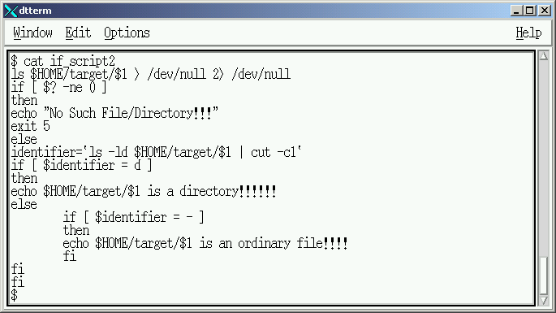
Original “if_script2” child

Slide 33
Original “if_script2” child

Slide 34
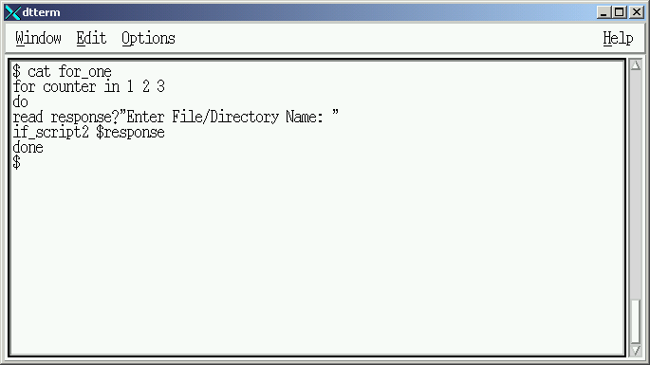
Create “for_one” parent

Slide 35
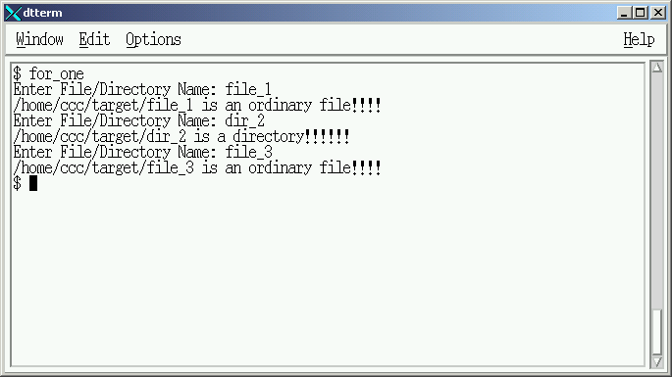
“for_one” Execution

Slide 36
Branching & Loops
Lesson Completed
Lab #4 – Review and Assign

